Slide 1
Indexing and Query Processing
Information Retrieval in Practice
All slides ©Addison Wesley

Slide 2
Indexes
Indexes are data structures designed to make search faster
Text search has unique requirements, which leads to unique data structures
Most common data structure is inverted index
general name for a class of structures
“inverted” because documents are associated with words, rather than words with documents
similar to a concordance

Slide 3
Indexes and Ranking
Indexes are designed to support search
faster response time, supports updates
Text search engines use a particular form of search: ranking
documents are retrieved in sorted order according to a score computing using the document representation, the query, and a ranking algorithm

Slide 4
Inverted Index
Each index term is associated with an inverted list
Contains lists of documents, or lists of word occurrences in documents, and other information
Each entry is called a posting
The part of the posting that refers to a specific document or location is called a pointer
Each document in the collection is given a unique number
Lists are usually document-ordered (sorted by document number)

Slide 5
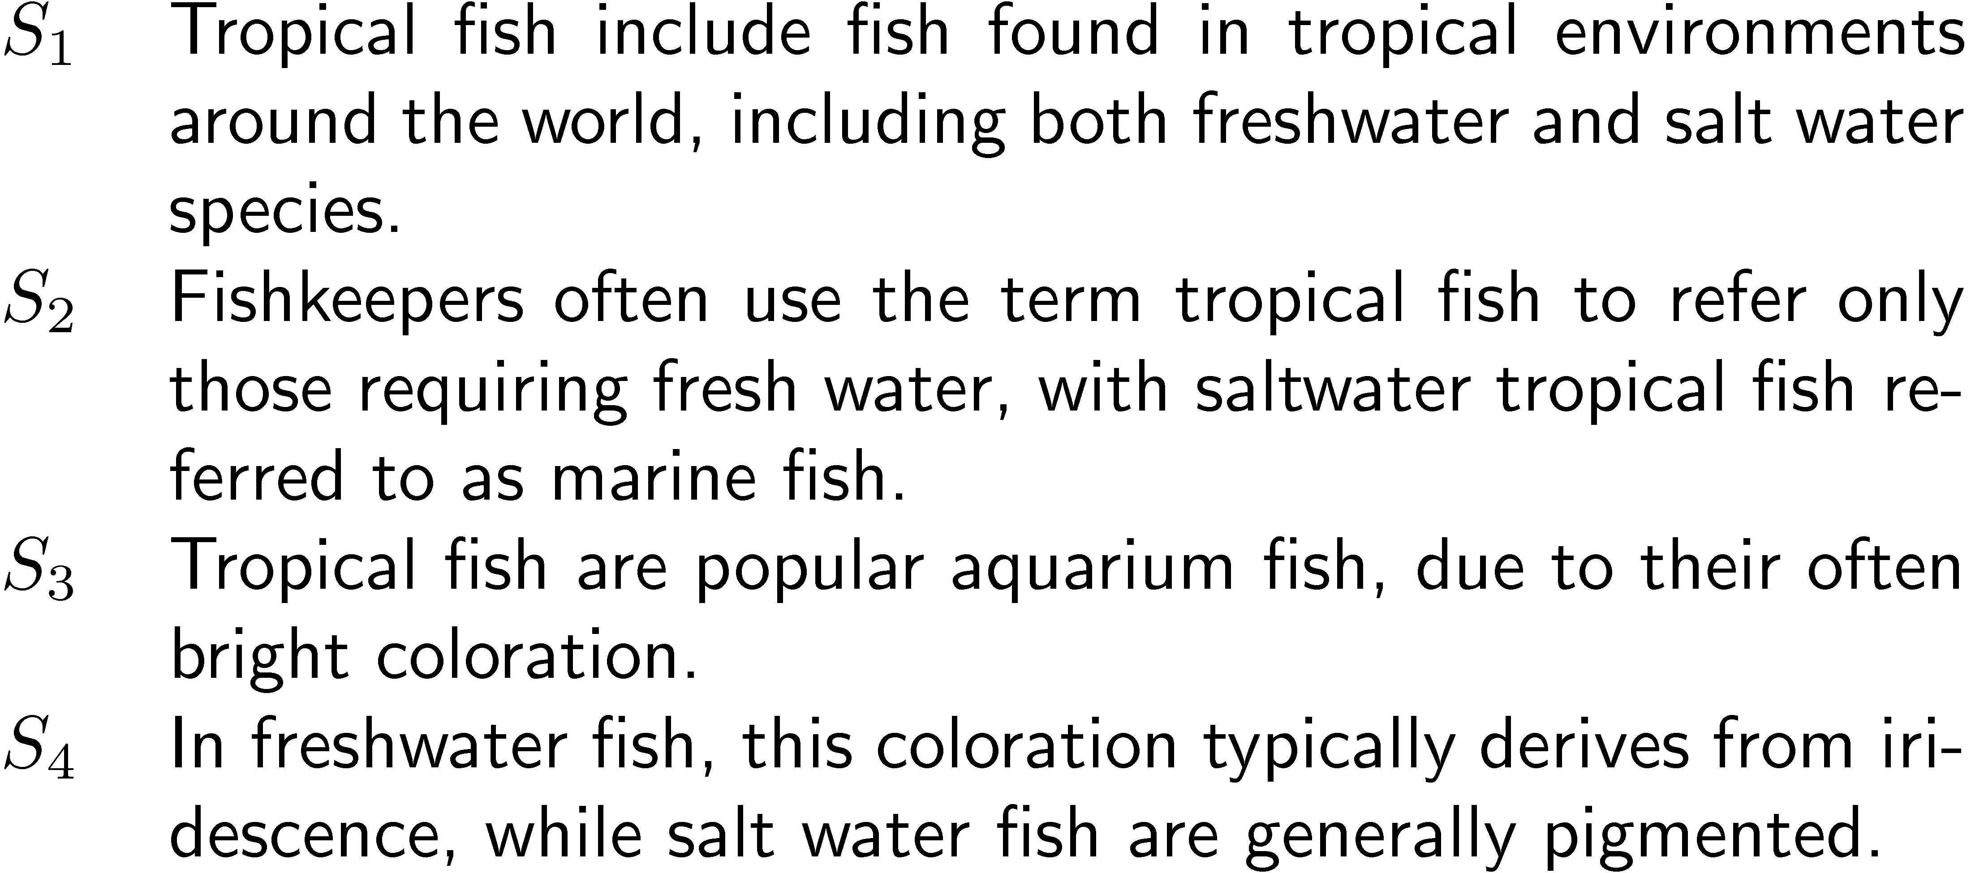
Example “Collection”

Slide 6
Simple Inverted Index

Slide 7
Inverted Index
with counts
supports better ranking algorithms

Slide 8
Inverted Index
with positions
supports
proximity matches

Slide 9
Proximity Matches
Matching phrases or words within a window
e.g., "tropical fish", or “find tropical within 5 words of fish”
Word positions in inverted lists make these types of query features efficient
e.g.,

Slide 10
Fields and Extents
Document structure is useful in search
field restrictions
e.g., date, from:, etc.
some fields more important
e.g., title
Options:
separate inverted lists for each field type
add information about fields to postings
use extent lists

Slide 11
Extent Lists
An extent is a contiguous region of a document
represent extents using word positions
inverted list records all extents for a given field type
e.g., title extent below shows that the title for Doc 1 is from word 1 to word 3. Hence, word fish appears once in title for Doc 1.
extent list

Slide 12
Other Issues
Precomputed scores in inverted list
e.g., list for “fish” [(1:3.6), (3:2.2)], where 3.6 is total feature value for document 1
improves speed but reduces flexibility
Score-ordered lists
query processing engine can focus only on the top part of each inverted list, where the highest-scoring documents are recorded
very efficient for single-word queries

Slide 13
Compression
Inverted lists are very large
e.g., 25-50% of collection for TREC collections
Much higher if n-grams are indexed
Compression of indexes saves disk and/or memory space
Typically have to decompress lists to use them
Best compression techniques have good compression ratios and are easy to decompress
Lossless compression – no information lost

Slide 14
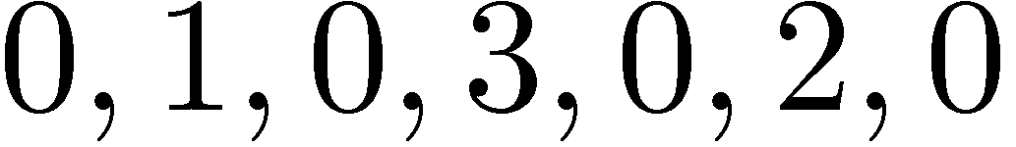
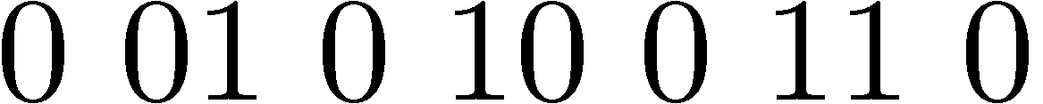
Compression
Basic idea: Common data elements use short codes while uncommon data elements use longer codes
Example: coding numbers
number sequence:
possible encoding:
encode 0 using a single 0:
only 10 bits, but...

Slide 15
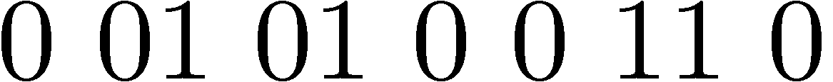
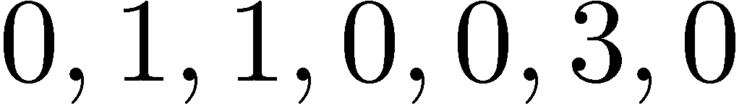
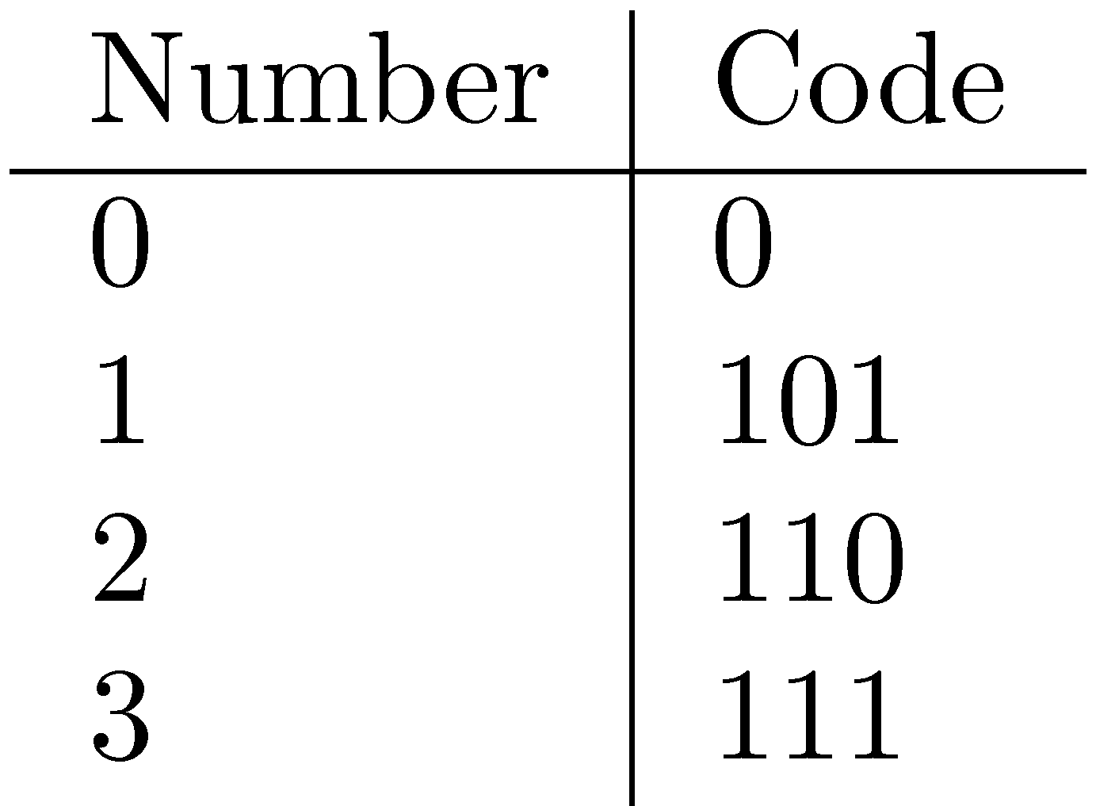
Compression Example
Ambiguous encoding – not clear how to decode
another decoding:
which represents:
use unambiguous code:
which gives:

Slide 16
Auxiliary Structures
Inverted lists usually stored together in a single file for efficiency because file systems inefficient for many small files
Inverted file
Vocabulary or lexicon
Contains a lookup table from index terms to the byte offset of the inverted list in the inverted file
Either hash table in memory or B-tree for larger vocabularies
Term statistics (e.g. document frequency) stored at start of inverted lists
Collection statistics (e.g. # docs in collection) stored in separate file

Slide 17
Query Processing
Document-at-a-time
Calculates complete scores for documents by processing all term lists, one document at a time
Term-at-a-time
Accumulates scores for documents by processing term lists one at a time
Both approaches have optimization techniques that significantly reduce time required to generate scores

Slide 18
Document-At-A-Time

Slide 19
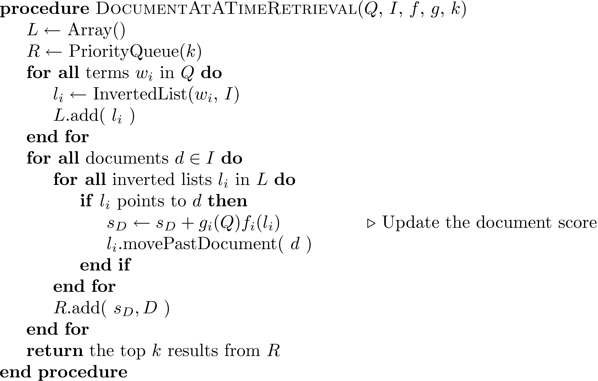
Document-At-A-Time

Slide 20
Term-At-A-Time

Slide 21
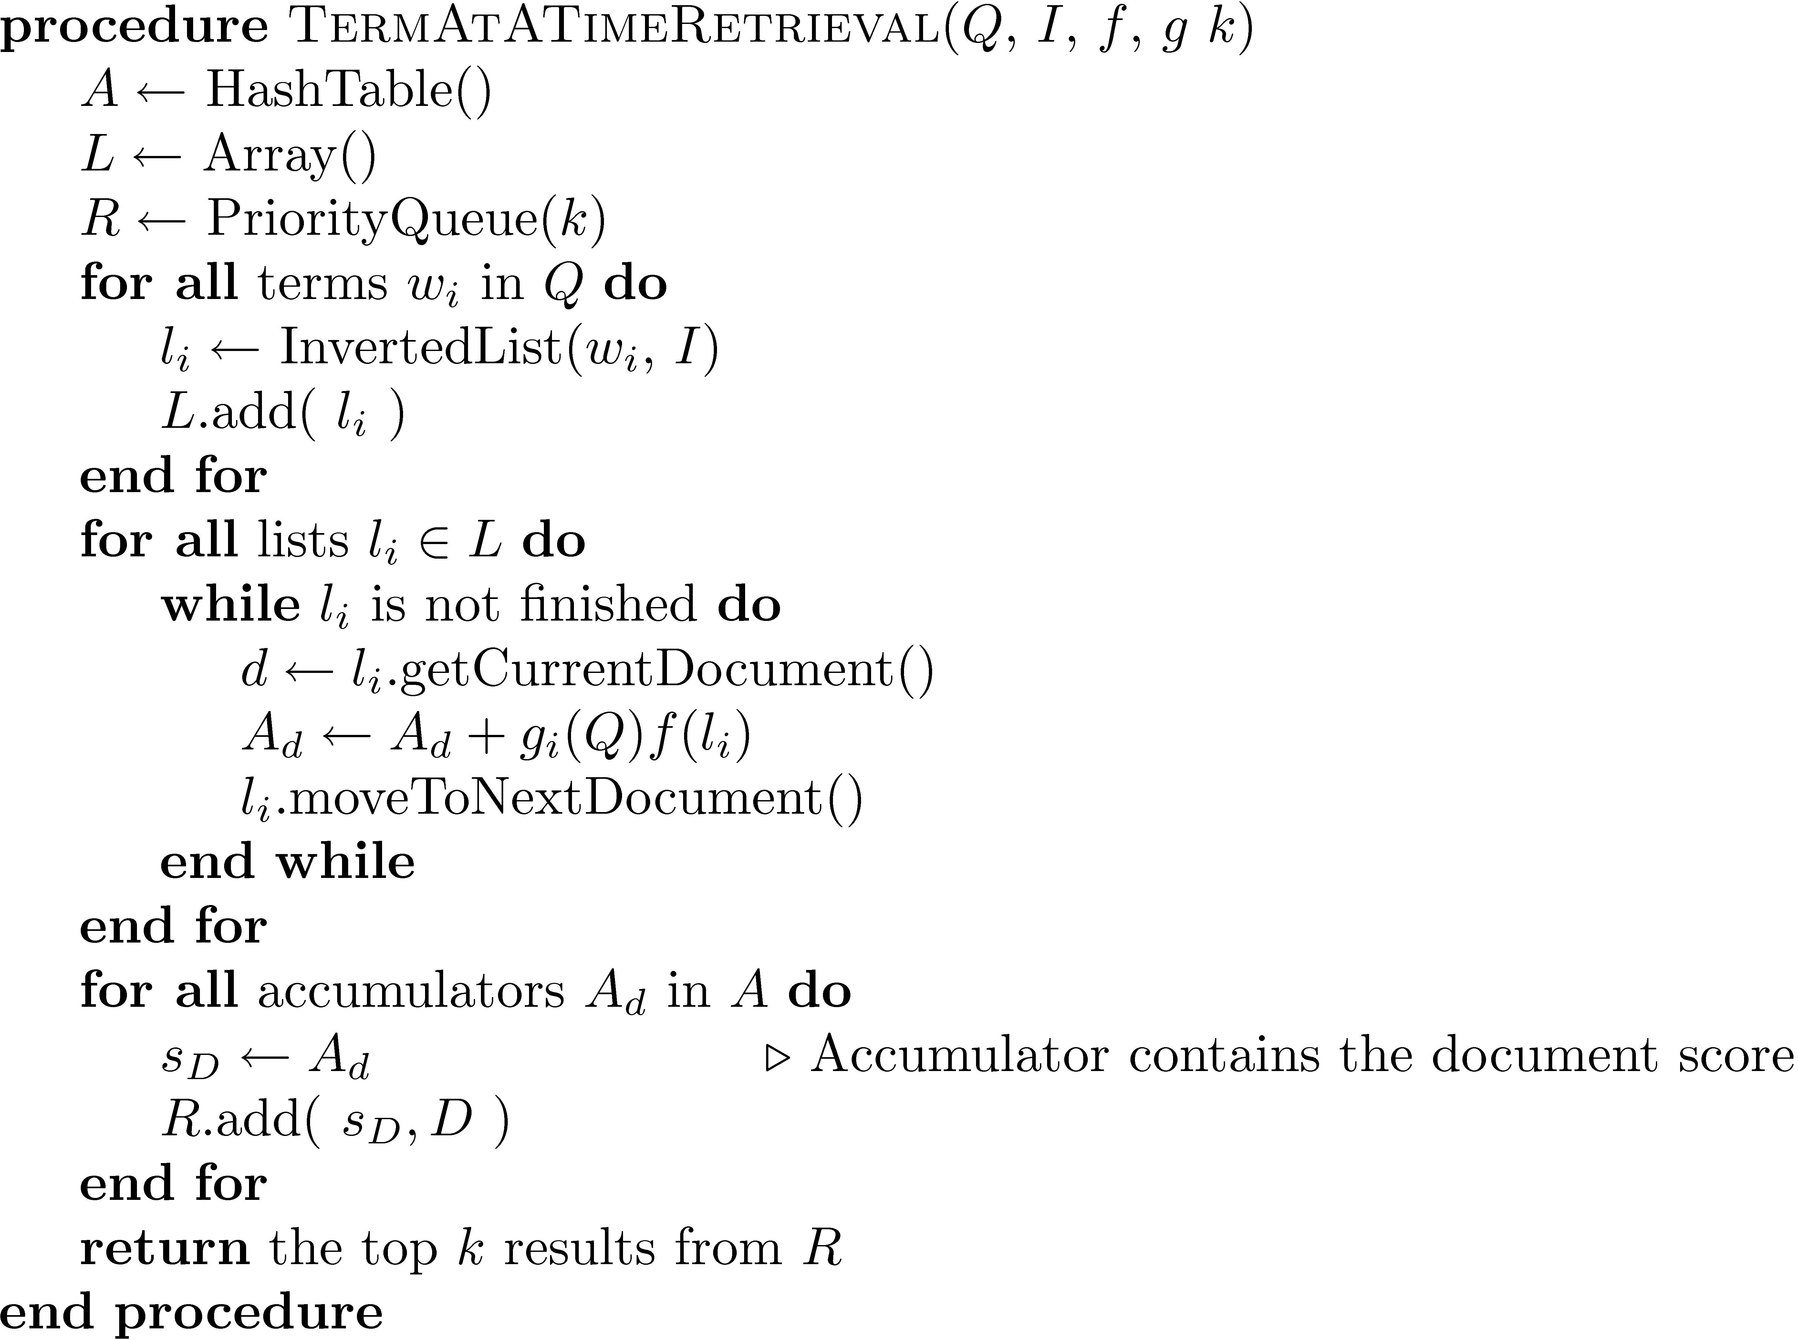
Term-At-A-Time

Slide 22
Trade-offs
Term-at-a-time uses more memory for accumulators, but accesses disk more efficiently
Document-at-a-time needs little memory (priority queue of top documents) but reads much of the inverted index.

Slide 23
Optimizations for Document-at-a-time query processing
Only read subset of posting lists to compute top-k elements with highest score
Variants for Document-at-a-time query processing:
Posting lists sorted by doc id
WAND algorithm: in each list, skip ranges of doc ids with no chance of being in top-k
Posting lists sorted by score
Non-Random Access (NRA) algorithm (variant of Threshold Algorithm (TA) when no random access allowed)

Slide 24
Skipping
Typically used when lists sorted by doc id
Search involves comparison of inverted lists of different lengths
Can be very inefficient
“Skipping” ahead to check document numbers is much better
Compression makes this difficult
Skip pointers are additional data structure to support skipping

Slide 25
Skip Pointers
n: length of inverted list
p: # postings to lookup
k: # bytes of skip pointer
c: distance between destinations of skip pointers
Expected # bytes read:
n/c intervals
Need to read kn/c bytes in skip pointers (gray boxes)
For each of p postings read on average c/2 bytes
Hence total # bytes = kn/c + pc/2
Depending on p, different c is optimal
Must also consider random vs. sequential hard disk speed.
Inverted list
skip pointers

Slide 26
Non-Random Access (NRA) Algorithm: Lists sorted by score
Query Q: q1,q2
q1: (D3,0.9), (D2,0.7), (D1,0.5),…
q2: (D6,0.9), (D3,0.8), (D7,0.4),…
Read in parallel from lists, and maintain min, max scores, and maximum possible score of unseen documents (Threshold)
After reading first two from q1 and q2, we know that D3 is the top-1

Slide 27
Other Optimizations
Early termination of query processing
ignore high-frequency word lists in term-at-a-time
ignore documents at end of lists in doc-at-a-time
unsafe optimization

Slide 28
Caching
Query distributions similar to Zipf
About ½ each day are unique, but some are very popular
Caching can significantly improve effectiveness
Cache popular query results
Cache common inverted lists
Inverted list caching can help with unique queries
Cache must be refreshed to prevent stale data

Slide 29
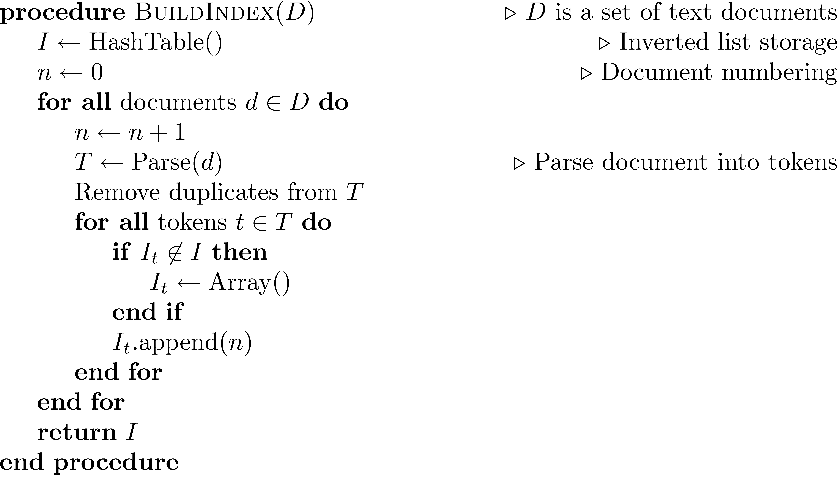
Index Construction
Simple in-memory indexer

Slide 30
Merging
Merging addresses limited memory problem
Build the inverted list structure until memory runs out
Then write the partial index to disk, start making a new one
At the end of this process, the disk is filled with many partial indexes, which are merged
Partial lists must be designed so they can be merged in small pieces
e.g., storing in alphabetical order

Slide 31
Merging

Slide 32
Handle Updates: Result Merging
Index merging is a good strategy for handling updates when they come in large batches
For small updates this is very inefficient
instead, create separate index for new documents, merge results from both searches
could be in-memory, fast to update and search
Deletions handled using delete list
Modifications done by putting old version on delete list, adding new version to new documents index

Slide 33
MapReduce: Distributed Indexing
Distributed processing driven by need to index and analyze huge amounts of data (i.e., the Web)
Large numbers of inexpensive servers used rather than larger, more expensive machines
MapReduce is a distributed programming tool designed for indexing and analysis tasks

Slide 34
Example
Given a large text file that contains data about credit card transactions
Each line of the file contains a credit card number and an amount of money
Determine the number of unique credit card numbers
Could use hash table – memory problems
counting is simple with sorted file
Similar with distributed approach
sorting and placement are crucial

Slide 35
MapReduce
Distributed programming framework that focuses on data placement and distribution
Mapper
Generally, transforms a list of items into another list of items of the same length
Reducer
Transforms a list of items into a single item
Definitions not so strict in terms of number of outputs
Many mapper and reducer tasks on a cluster of machines

Slide 36
MapReduce
Basic process
Map stage which transforms data records into pairs, each with a key and a value
Shuffle uses a hash function so that all pairs with the same key end up next to each other and on the same machine
Reduce stage processes records in batches, where all pairs with the same key are processed at the same time
Fault tolerance

Slide 37
MapReduce

Slide 38
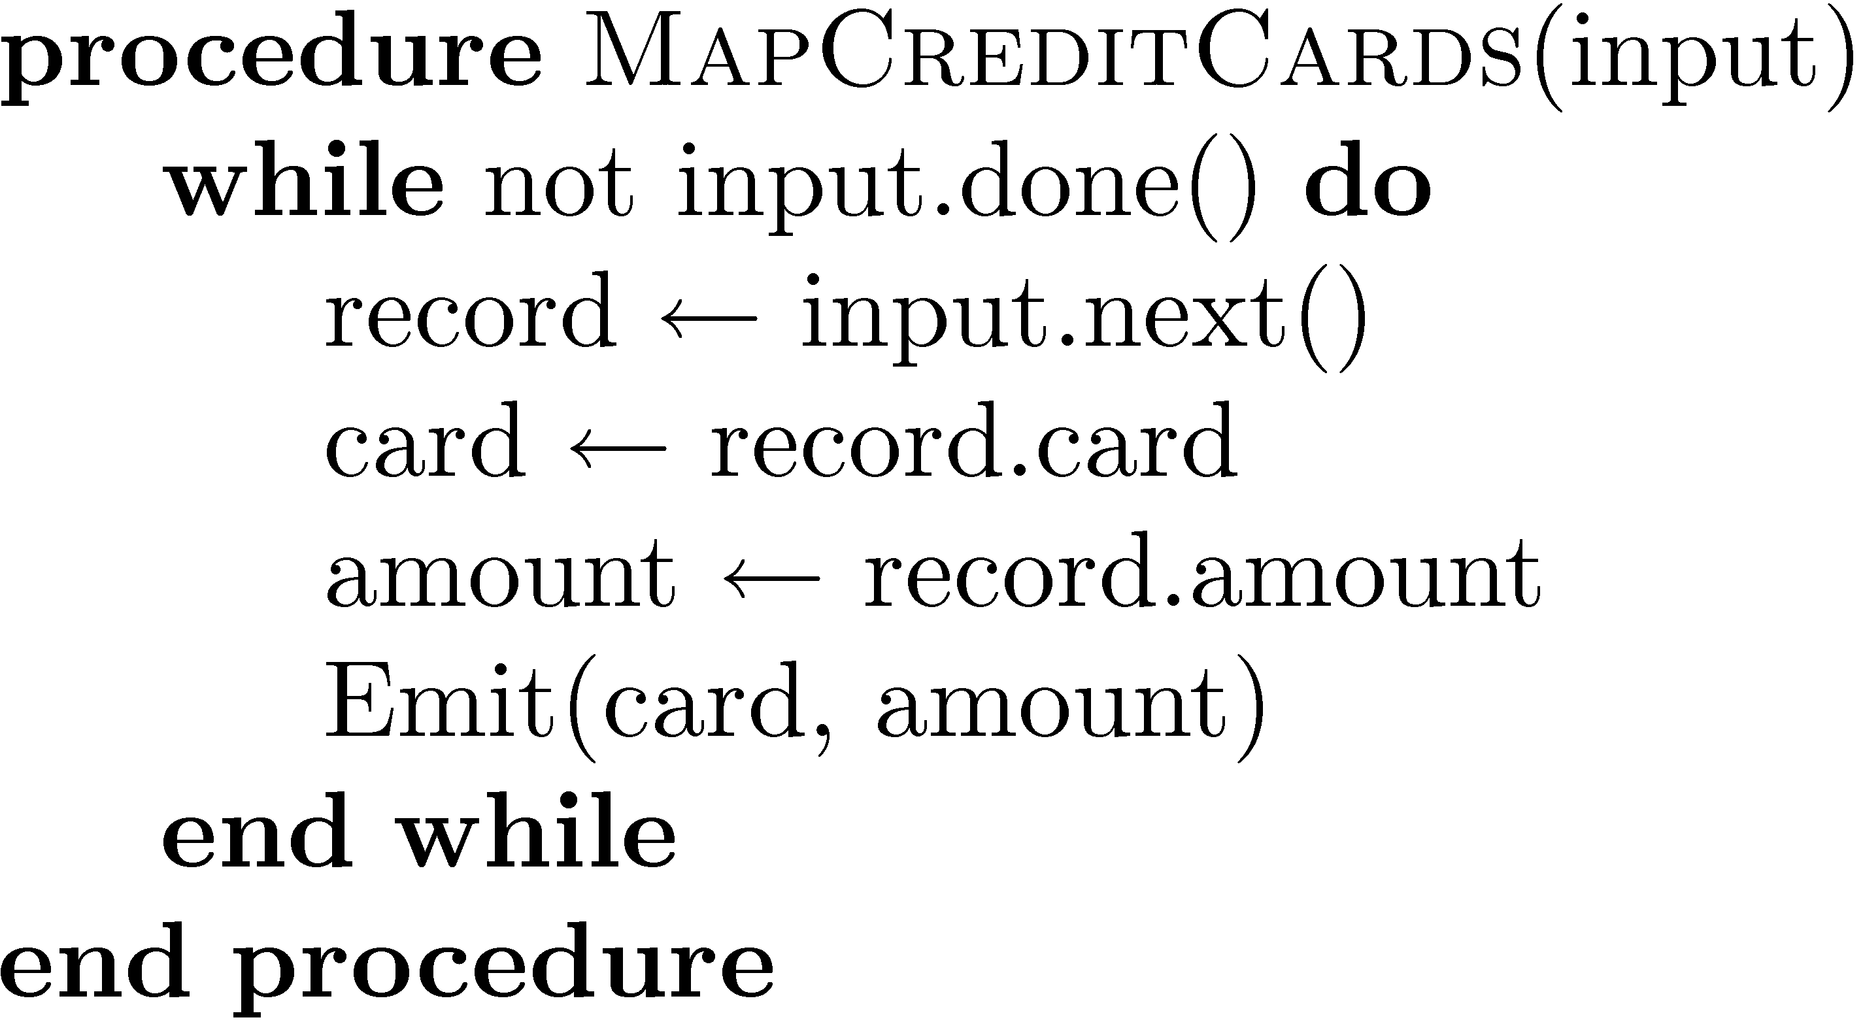
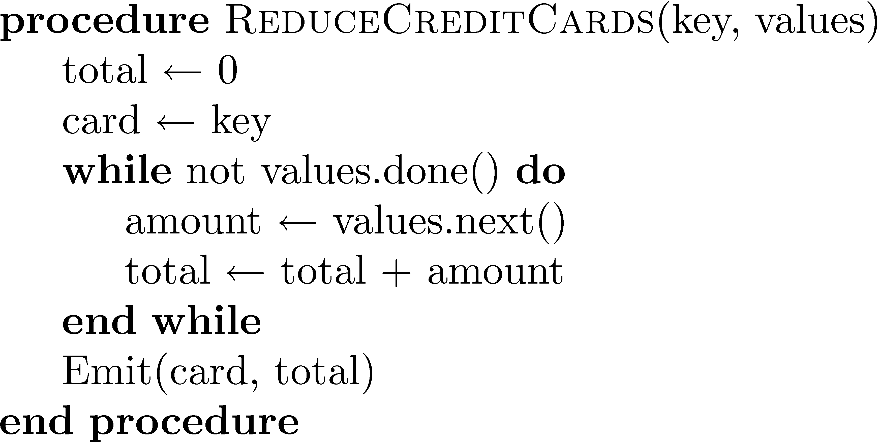
Example

Slide 39
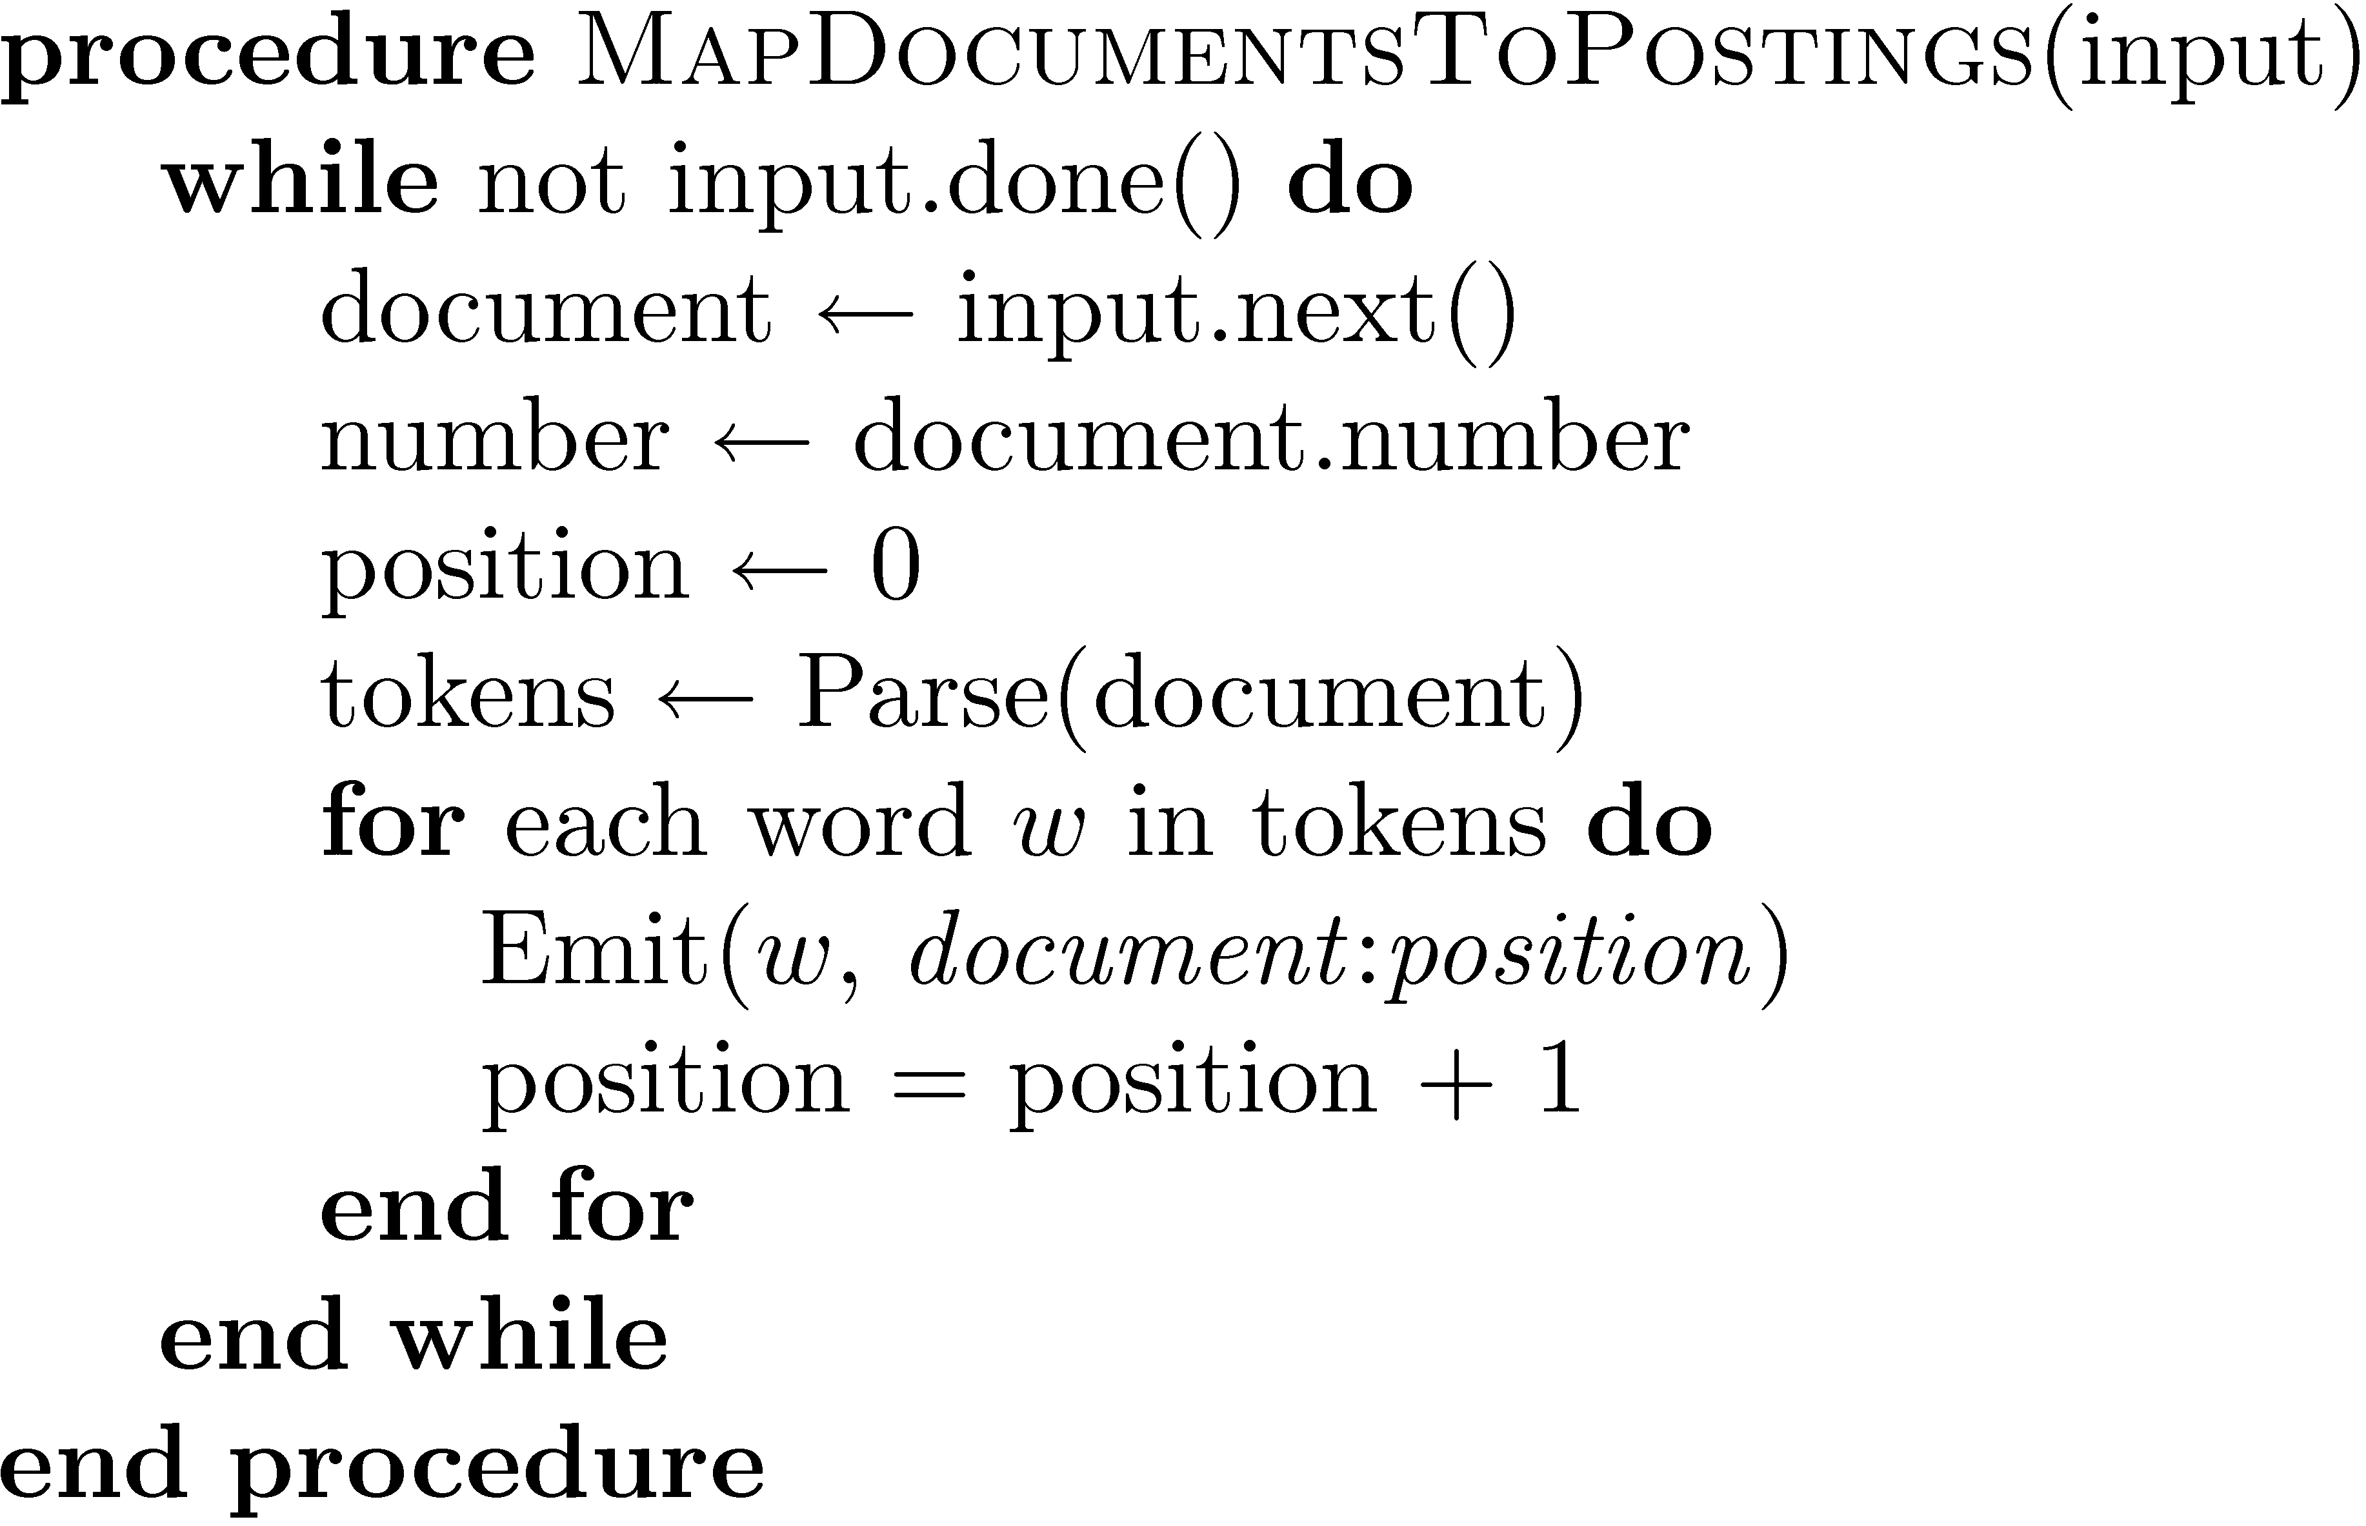
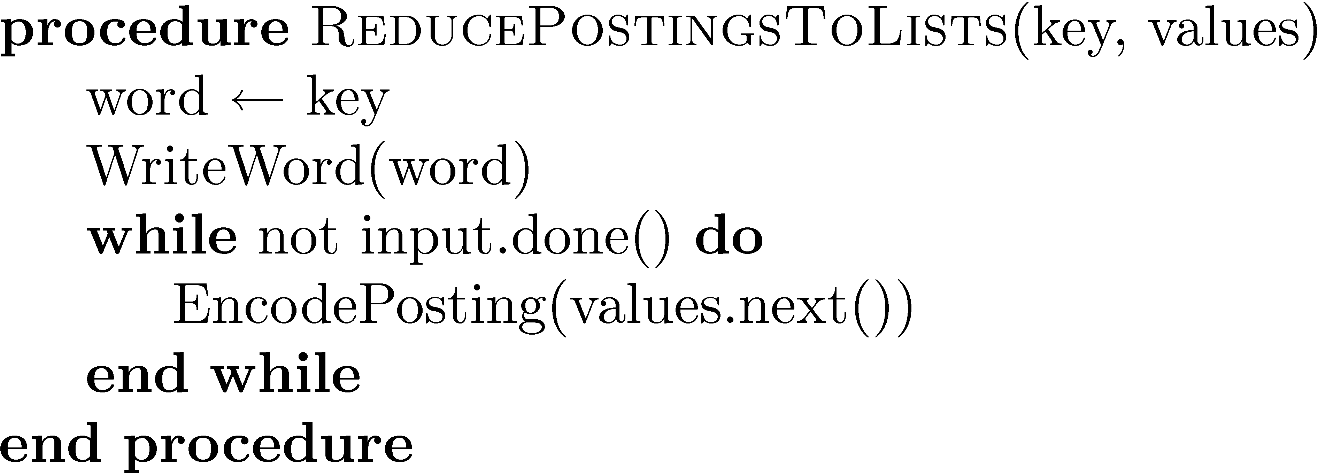
Indexing Example

Slide 40
Hadoop works on top of HDFS
HDFS is a distributed file system
Makes some unique tradeoffs that are good for MapReduce
What HDFS does well:
Very large read-only or append-only files (individual files may contain Gigabytes/Terabytes of data)
Sequential access patterns
What HDFS does not do well:
Storing lots of small files
Low-latency access
Multiple writers
Writing to arbitrary offsets in the file

Slide 41



How data is stored in HDFS
foo.txt: 3,9,6 bar.data: 2,4
block #2 of foo.txt?
3
9
Name node
4
9
2
6
9
Read block 9
2
3
4
9
6
2
4
3
9
Client
Data nodes
Files are stored as sets of (large) blocks
Default block size: 64 MB (ext4 default is 4kB!)
Blocks are replicated for durability and availability
What are the advantages of this design?
Namespace is managed by a single name node
Actual data transfer is directly between client & data node
Pros and cons of this decision?

Slide 42
Recap: High-level dataflow
Intermediate (key,value) pairs
Mapper
Reducer
Mapper
Reducer
Input data
Output data
Mapper
Reducer
Mapper
Reducer
"The Shuffle"

Slide 43
Detailed dataflow in Hadoop
Node 1
Node 2
InputFormat
InputFormat
File
File
File
File
Split
Split
Split
Split
Split
Split
Local HDFS store
Local HDFS store
RR
RR
RR
RR
RR
RR
map
map
map
map
map
map
Combine
Combine
Partition
Partition
Sort
Sort
Reduce
Reduce
OutputFormat
OutputFormat
Notes:
RR: RecordReader converts the byte-oriented view of the input, provided by the InputSplit, and presents a record-oriented to the Mapper implementations for processing. RecordReader thus assumes the responsibility of processing record boundaries and presents the tasks with keys and values.

Slide 44
End

Slide 45
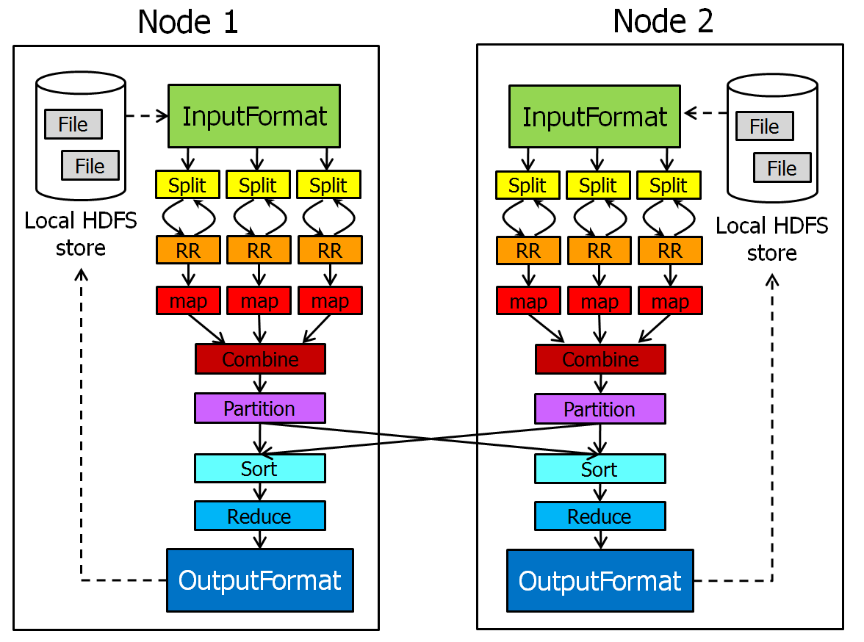
More Hadoop Details: Input Format
Defines which input files should be read, and how
Defaults provided, e.g., TextInputFormat, DBInputFormat, KeyValueTextInputFormat...
Defines InputSplits
InputSplits break file into separate tasks
Example: one task for each 64MB block (why?)
Provides a factory for RecordReaders
RecordReaders actually read the file into (key,value) pairs
Default format, TextInputFormat, uses byte offset in file as the key, and line as the value
KeyValueInputFormat reads (key,value) pairs from the file directly; key is everything up to the first tab character

Slide 46
Combiners
Optional component that can be inserted after the mappers
Input: All data emitted by the mappers on a given node
Output passed to the partitioner
Why is this useful?
Suppose your mapper counts words by emitting (xyz, 1) pairs for each word xyz it finds
If a word occurs many times, it is much more efficient to pass (xyz, k) to the reducer, than passing k copies of (xyz,1)

Slide 47
Parititoner
Controls which intermediate key-value pairs should go to which reducer
Defines a partition on the set of KV pairs
Number of partitions is the same as the number of reducers
Default partitioner (HashPartitioner) assigns partition based on a hash of the key

Slide 48
Output Format
Counterpart to InputFormat
Controls where output is stored, and how
Provides a factory for RecordWriter
Several implementations provided
TextOutputFormat (default)
DBOutputFormat
MultipleTextOutputFormat
...

Slide 49
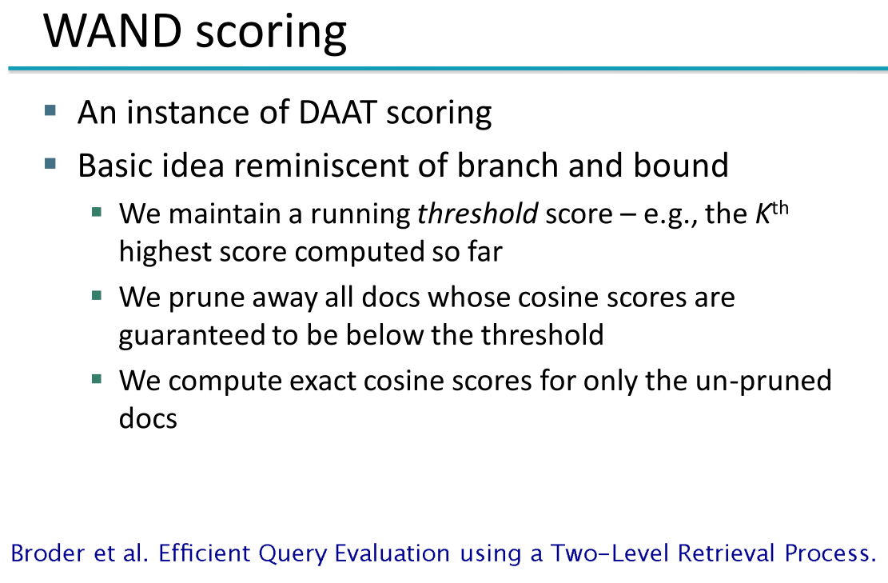
WAND slides taken from Chris Manning, Pandu Nayak and Prabhakar Raghavan

Slide 50
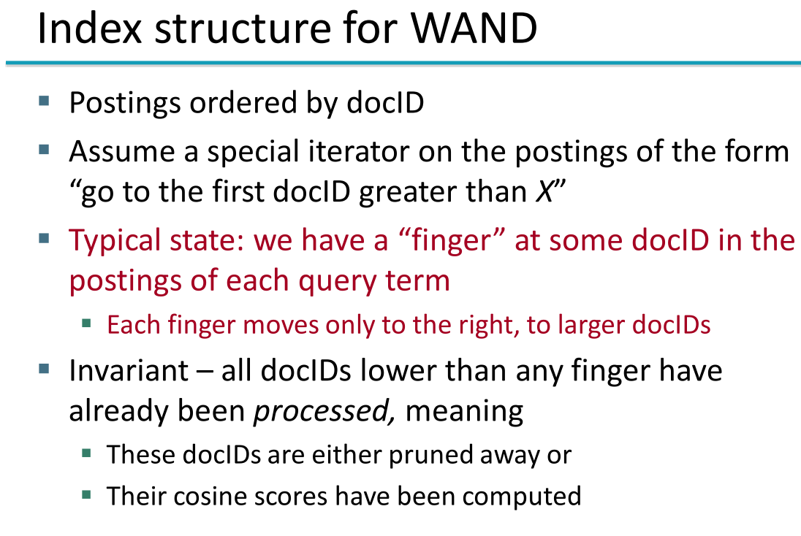

Slide 51
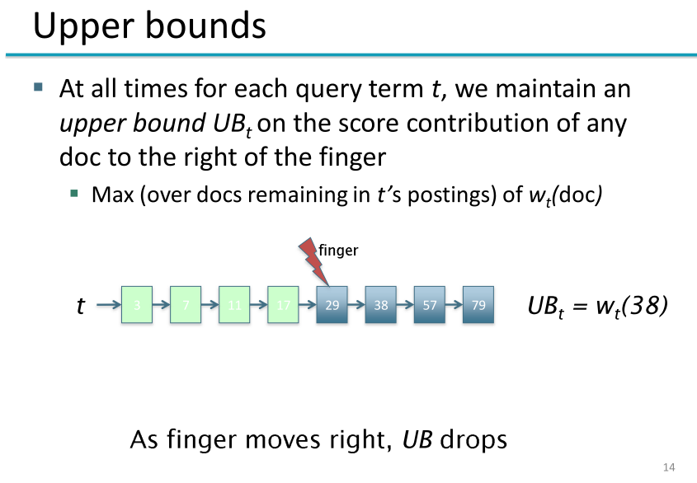

Slide 52
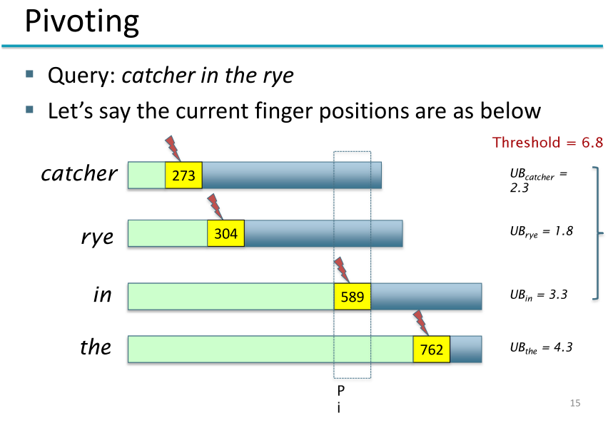

Slide 53
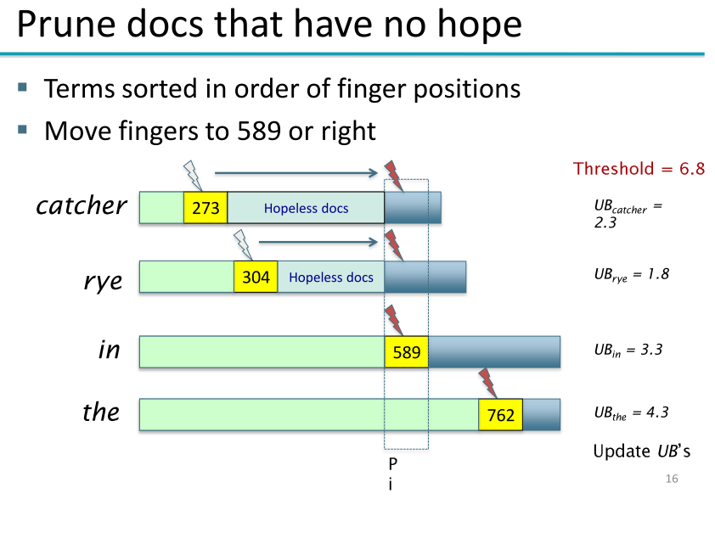

Slide 54
